Slide 1
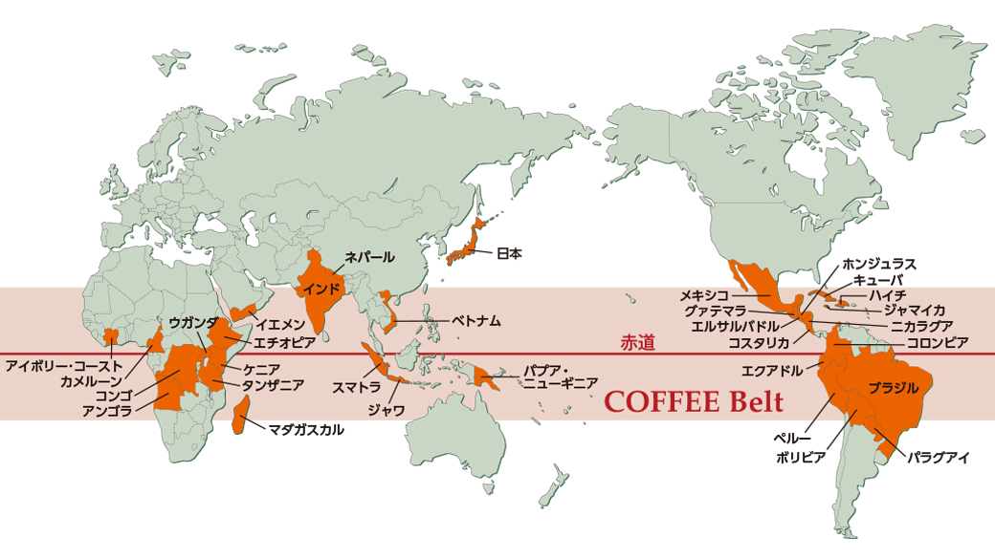
Why Coffee exports dropped?

Slide 2

1
Exports Declining Patterns
2
(1) Reason from Consumption Side
(2) Reason from Prices Side
*based on the data from ICO

Slide 3
Exports Declining Patterns
Short-term decline in recent months

Slide 4
Exports Declining Patterns (Seasonal)
Compare to the corresponding months last year
Lower than the same time in 2018

Slide 5
PART 2 - Possible Reasons: Analysis of data
Consumption in Producing Countries
Price Declining Trend

Slide 6
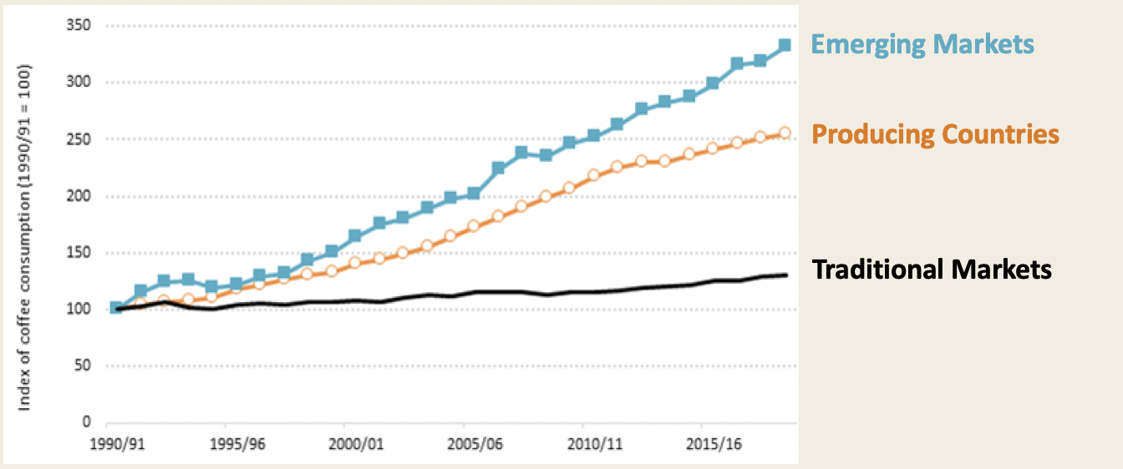
Global coffee consumption growth
The consumption growth: Producing countries > Traditional markets
Increasingly domestic demands -> decline in exports

Slide 7
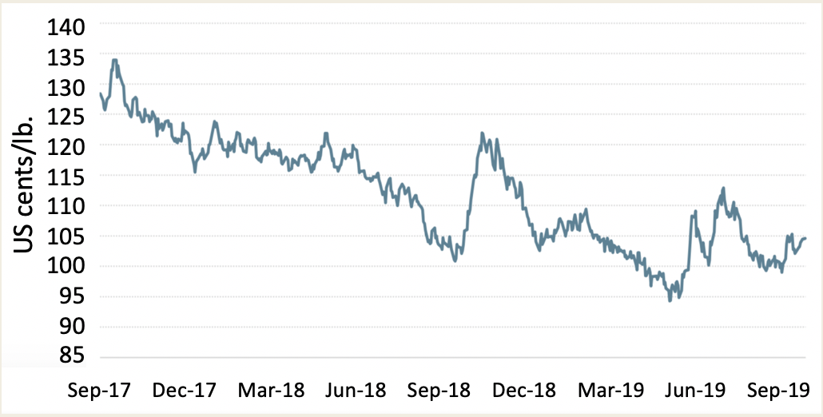

ICO Global Coffee Daily Prices
140
135
130
125
120
115
110
105
100
95
90
85
Come from
ICO Composite
Indicator Daily
Prices data
Drift downwards since 2017
US cents/lb.

Slide 8
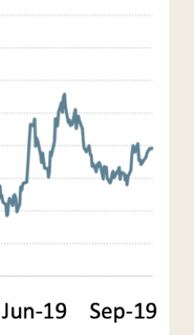
ICO Global Coffee Daily Prices
140
135
130
125
120
115
110
105
100
95
90
85
Come from
ICO Composite
Indicator Daily
Prices data
Same period as exports decline
US cents/lb.

Slide 9



{
1 contradictory phenomenon
2 possible reasons
Consumption
Prices
Sum: Short term phenomenon;
Price will rebound & exports will increase

Slide 10


Thank you!
Q & A

